Slide 1
Mobile Web
Jeremy Foster
Christopher Harrison

Slide 2
Course Topics
Mobile Web
01 | Designing for Mobile | 05 | The Mobile Client
02 | Mobile UI | 06 | Offline Data
03 | Integrating Touch | 07 | Publishing to Azure
04 | Setting Up the Server
Notes:
jeremy

Slide 3
07 | Publishing to Azure
Jeremy Foster | @codefoster
Christopher Harrison | @GeekTrainer

Slide 4
Module Overview
Multi-Device Hybrid Apps Tooling
Deploying to Azure

Slide 5
Multi-Device Hybrid Apps Tooling

Slide 6
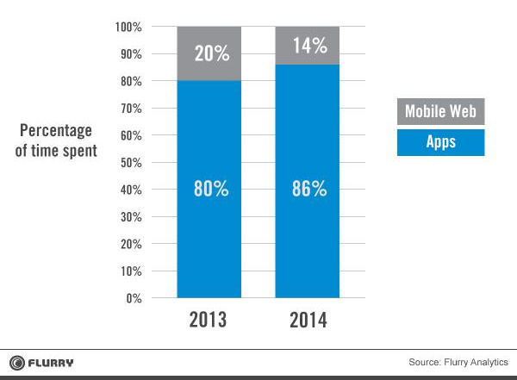
Apps dominate the mobile web
Notes:
Web apps provide no access to native device capabilities, no offline scenario and poor discoverability.

Slide 7
Low investment for more capabilities
Native App
Developer Investment
Web App
Hybrid App
Capabilities

Slide 8

What is Apache Cordova?
Open-source framework
Notes:
Originally made by Nitobi and purchased by Adobe in 2011.

Slide 9
What is Apache Cordova?
Native Wrapper
Open-source framework
Hosted webview
Single, shared codebase deployed to all targets
<webview> Your JavaScript App
Notes:
Originally made by Nitobi and purchased by Adobe in 2011.

Slide 10


What is Apache Cordova?
Native Wrapper
Open-source framework
Hosted webview
Single, shared codebase deployed to all targets
Plugins provide a common JavaScript API to access device capabilities
<webview> Your JavaScript App
Cordova Plugin JS API
Notes:
Originally made by Nitobi and purchased by Adobe in 2011.

Slide 11
What is Apache Cordova?
Native Wrapper
Open-source framework
Hosted webview
Single, shared codebase deployed to all targets
Plugins provide a common JavaScript API to access device capabilities
About 6% of apps in stores (13% in enterprise)
<webview> Your JavaScript App
Cordova Plugin JS API
Notes:
Originally made by Nitobi and purchased by Adobe in 2011.

Slide 12
Why Cordova?
Source: Kendo UI Developer Survey 2013

Slide 13
Why Hybrid?
Leverage existing:
Assets
Processes
Skillsets
Speed to market
Broad reach

Slide 14
Let’s look at the code

Slide 15
Tips, Tricks & Considerations
Use Cordova when an idea makes sense as a web app, but you need…
Offline support
Access to native device capabilities
Better reach & discoverability
Don’t use Cordova when you’re making a first-person shooter. Go native.
Cordova depends on the platform build system
To build for iOS, you need a Mac
To build for Windows 8+, you need Windows 8+
To build for Android, you need the Android SDK
Custom plugins are great! But, really… check the support matrix
When you debug on a device, remember to install the drivers

Slide 16
I <3 your feedback
Download the extension: http://aka.ms/cordova
StackOverflow #multi-device-hybrid-apps
Email the product team: vscordovatools@micrososft.com

Slide 17
Deploying to Azure

Slide 18
Three Deployment Methods
FTP
Visual Studio Publish
Publish from source control

Slide 19
Resources
aka.ms/mdha
aka.ms/kudu
aka.ms/azurewebsites

Slide 20
Summary
Multi-device hybrid apps tooling
Deploying to Azure

